Slide 1

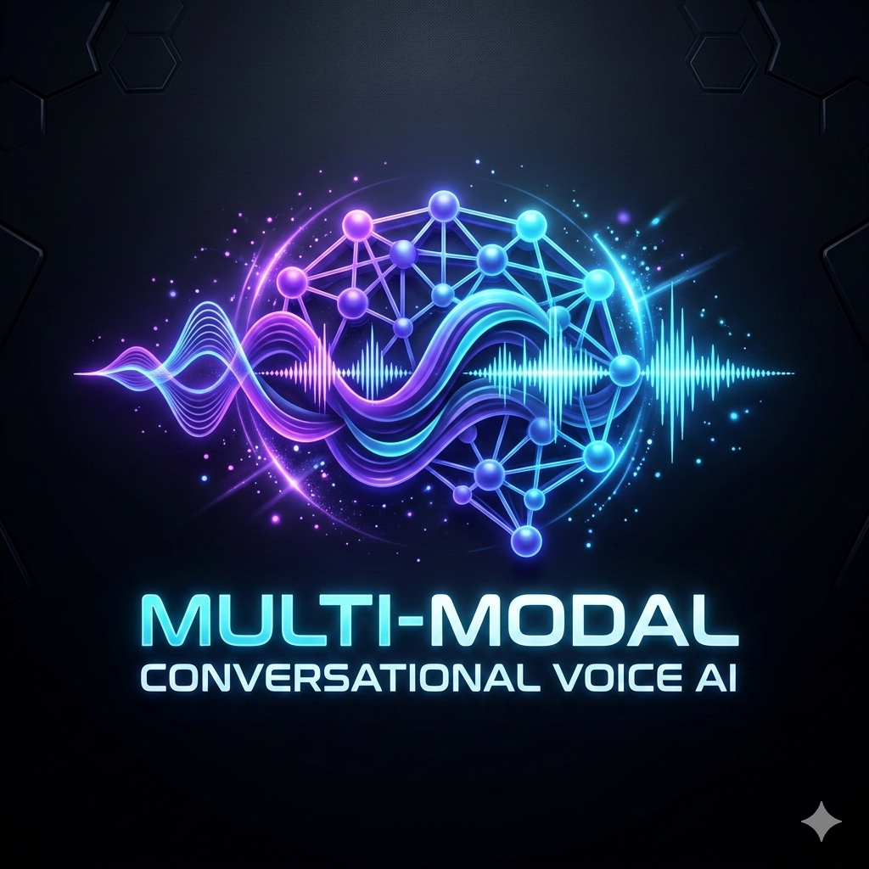
Agentic AI Summit 2026
Building Multi-Modal
Conversational
Voice AI Agents
Next-generation interactive voice systems powered by real-time speech synthesis, LLMs, and multi-modal interaction.
Presented By
record_voice_over
Ishika Gupta
Voicecare.ai
psychology
Srashti Kaurav
Bosch
graphic_eq
Notes:
I’m Ishika Gupta, working as a Senior AI Engineer at VoiceCare.ai, where I work at the intersection of healthcare and conversational AI, building intelligent voice agents that are designed to understand conversations.
And today, we’re going to take that experience and bring it into this room!
I’m delighted to be accompanied by my friend and a very talented NLP Engineer, Srashti Kaurav, who works at Bosch. She brings her own expertise in Natural Language Processing and a passion for exploring how machines understand human language. Together, we’ll help you navigate the journey from understanding voice AI to actually building one.
You: “Now, based on the number of hands I saw, I think most of you are familiar with LLMs. So let me ask you something.”
You: “Can anyone tell me the difference between an LLM and an AI agent?”
[Pause for 5–10 seconds. Look around the room. Let students answer.]
If someone says, “An agent can perform tasks,” respond:
You: “Exactly! That's a good starting point. But let’s understand what that actually means.”
If nobody answers, keep it light:
You: “Come on, don't worry! This isn't an exam, and I'm not collecting your answer sheets!” 😄
You: “Let me make it easier. Imagine you ask ChatGPT: ‘Plan a five-day trip to Mysore.’ It gives you a beautiful itinerary. Great! Now imagine another AI that can ask you about your budget, search for suitable hotels, compare activities, calculate costs, and adjust the plan when you change your mind.”
You: “What's the difference? What extra capabilities does the second system need?”
[Invite two or three students to respond.]
You: “Exactly! An LLM generates responses based on the input and context it receives. An AI agent uses an LLM as part of a larger system that can decide what to do next, use tools, observe the results, and continue working toward a goal.”
You: “So remember this distinction: an LLM is just a model; an agent is an autonomous system built around a model, with instructions, tools, and a way to take action based on the external available info.”
3. Make them think: Is every chatbot an agent?
You: “Let's do a quick challenge. I'll give you 2 examples. You tell me: LLM-powered chatbot or AI agent?”
Example 1: “You ask an AI to explain recursion, and it gives you an explanation.”
[Ask the audience: “Agent or chatbot?”]
You: “Mostly a straightforward LLM-powered interaction. It answers your question.”
Example 2: “You ask an AI to check your calendar, find a free slot tomorrow, and schedule a meeting with your professor.”
[Ask the audience to vote.]
You: “Now we're getting into agent territory! It needs to access a calendar tool, inspect the available slots, and take an action. Of course, the system must have the right permissions.”
You: “Now, one more question. If we already have LLMs that can reason and AI agents that can use tools, why do we need a separate voice AI architecture?
You: “Because talking is not simply typing with a microphone!”
You: “When we speak, the system must process audio, recognize our words, understand when we've finished speaking, generate a response, and speak it back. And it needs to do all of this with low latency.”
You: “And there's another complication. Humans interrupt each other all the time. We change our minds halfway through a sentence. We say, ‘Actually, no, forget that!’”
You: “Our AI agent needs to handle that naturally, too. So building voice AI isn't just about making an LLM speak. It's about orchestrating an entire real-time system.”
You: “And that's exactly what we're going to explore today. First, I'll show you a working voice AI agent. Then we'll open the hood and understand what's happening behind the scenes.”
Before we start talking about the technical details. I want to do something slightly different.
I don't want to explain what we're going to build. I want to show you what we're going to build.
So… Let me introduce you to TripMate.
TripMate is a voice AI travel agent - which helps plan the travel across cities in India.
And I'm going to have a completely natural conversation with it.
Not a chatbot conversation.
A conversation.
Let's see what happens.
Start the demo.
"Hey TripMate, I want to plan a trip."

Slide 2
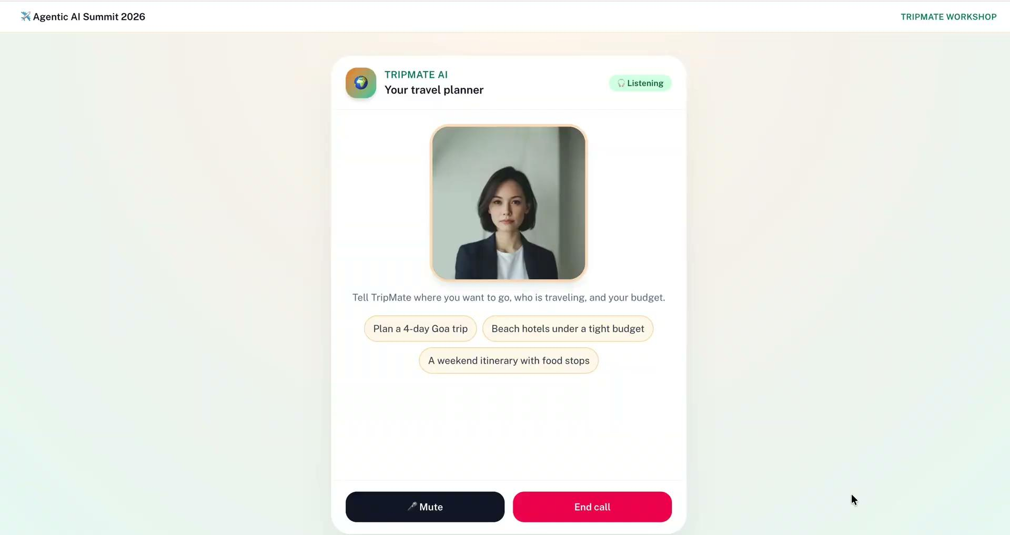
Notes:
"So... what just happened?"
Was that a chatbot?
Was that a voice assistant?
Was that an LLM?
Actually...
it's a little bit of all of them — but it's also something more.
Now notice what you just experienced.
I didn't type anything.
I didn't press a button after every sentence.
I didn't say:
"Now call the hotel search API."
I didn't tell it:
"Now calculate my budget."
I simply talked.
And the system had to figure out:
What did I say?
What did I mean?
Does it need a tool?
Which tool?
What information does it need first?
What should it say back to me?
And all of that happened while we were having a conversation.
That's the difference I want you all to understand today.
We're moving from:
"AI that answers questions" -> TO
"AI that participates in conversations and actually gets things done."
So what do u guys think, what does it take for a normal agent to become a conversational one????
Great! You've already identified some important pieces.
Lemme show you the differences between a normal chatbot and a conversational voice agent system.

Slide 3
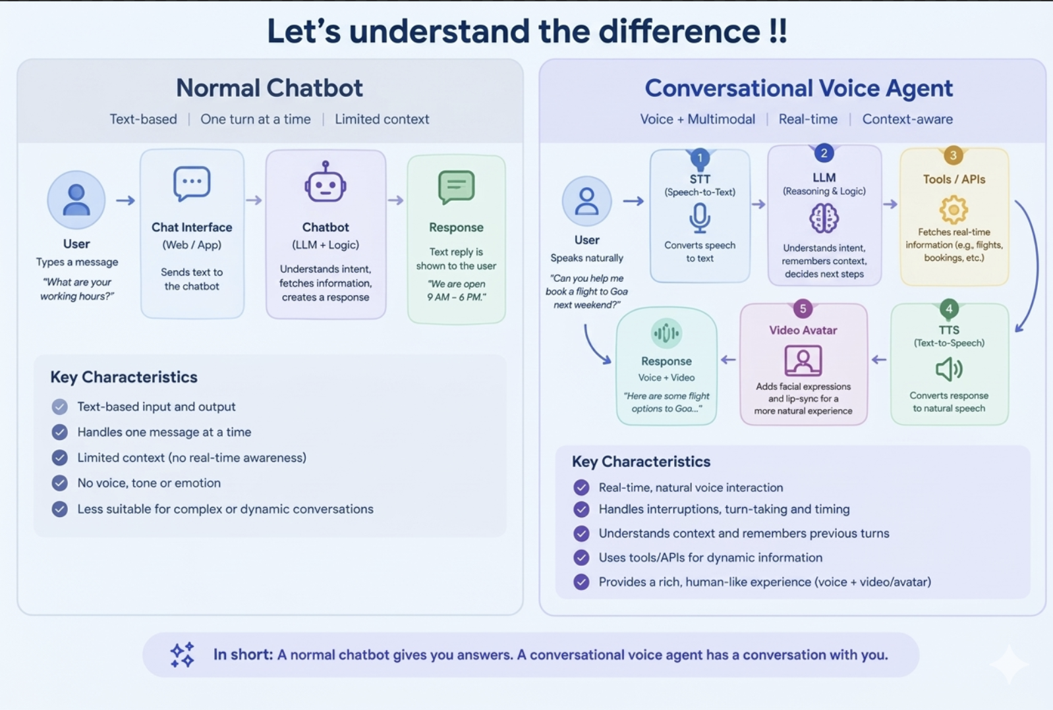
Notes:
On the left, we have a normal chatbot. We type a message, the chatbot processes it, and we get a text response. It's useful, but the interaction is generally text-based.
Now, look at the right. A conversational voice agent takes things a step further. We can speak naturally, and the system processes our speech, understands the context, reasons about what to do, and can use tools or APIs to fetch information before responding with speech.
But here's the interesting part: a good voice agent doesn't just speak—it knows when to listen, when to respond, and when to let us interrupt. It also needs to manage latency so the conversation feels natural.

Slide 4
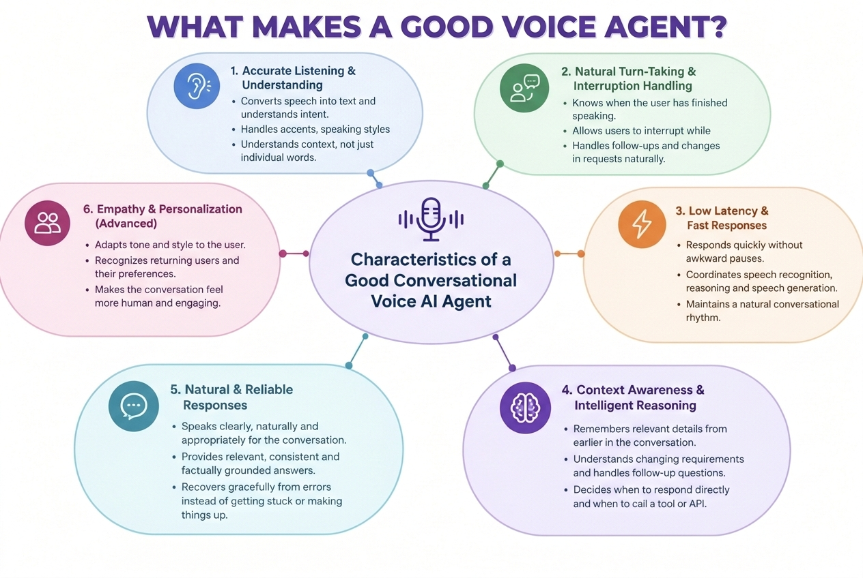
Notes:
Remember when I told TripMate that I was travelling with my parents? A good agent shouldn't just process that sentence in isolation. It should use that information to adapt its recommendations.

Slide 5
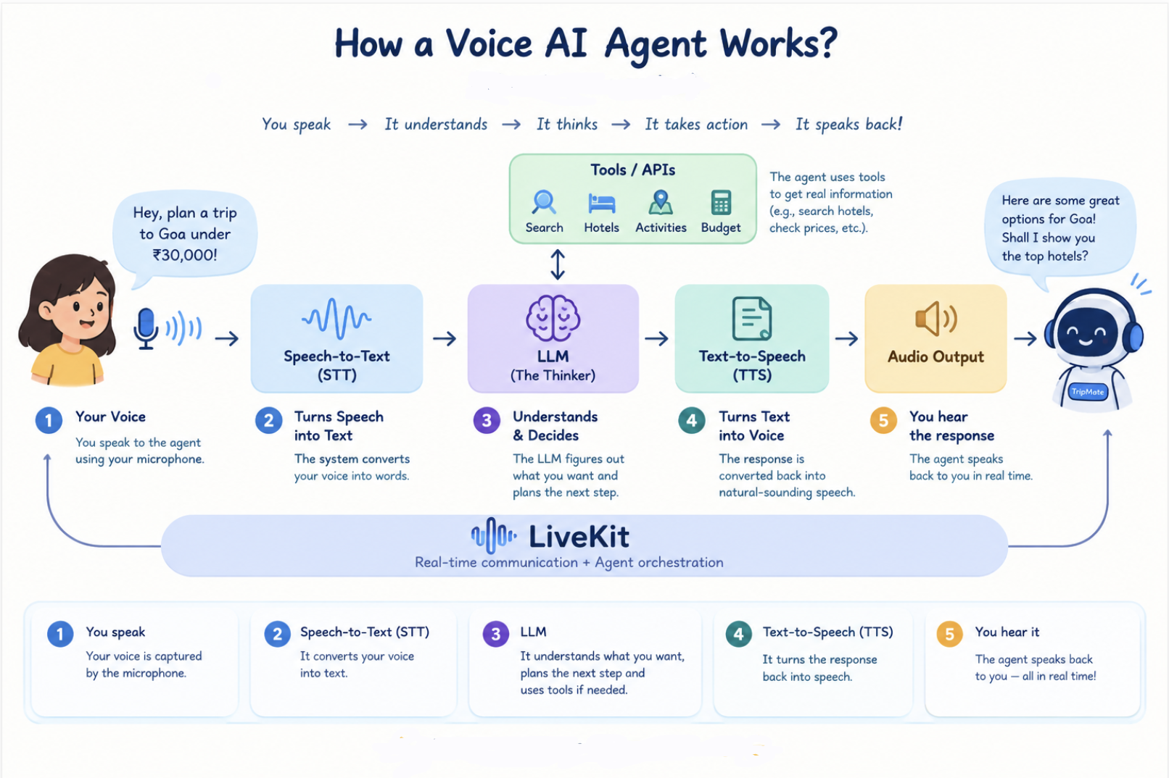

Slide 6
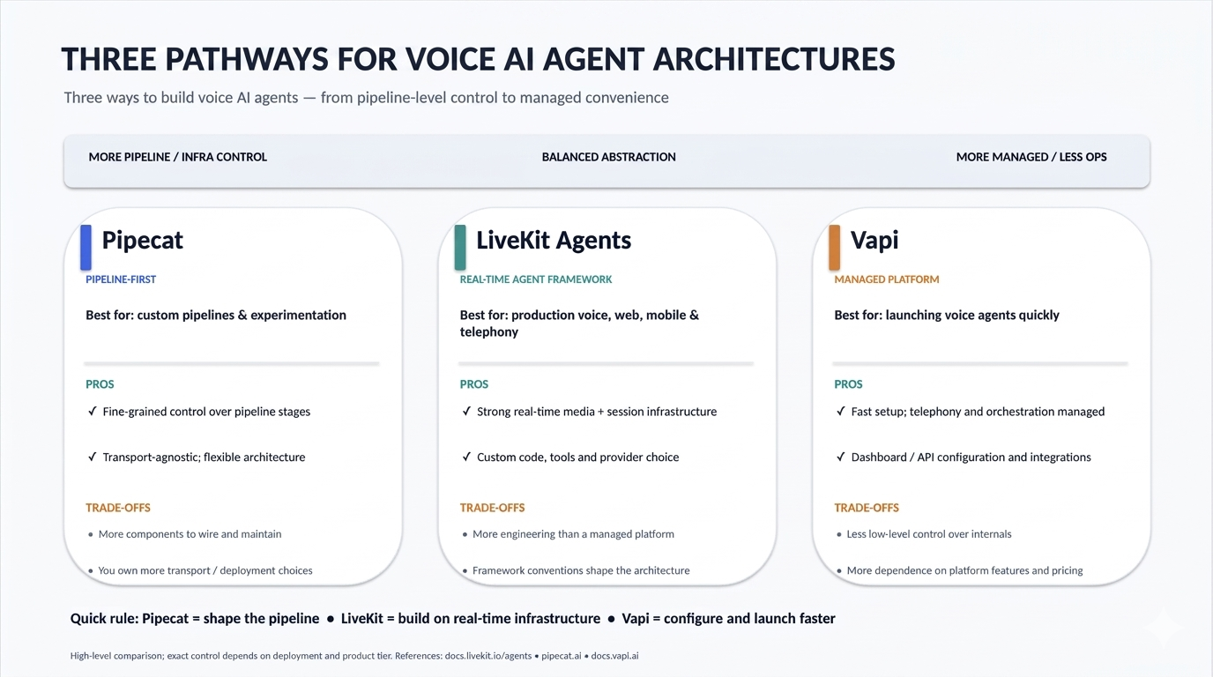
Notes:
Everyone can create their own Livekit account: https://cloud.livekit.io/login
Your agent, however, will run from your own LiveKit project and your own Colab environment.
So when you change your Python code...We're going to start with the simplest possible agent. Srashti will take you forward from concept/theory to practical implementation. Over to you!!

Slide 7

LIVEKIT REAL-TIME VOICE AI ORCHESTRATION
LIVEKIT ROOM
USER
🗄️ MEMORY
WEBRTC TRANSPORT
📋 CONTEXT
SESSION STATE
VAD & TURN DETECTION
⚡ INTERRUPTION MODULE
OBSERVABILITY DASHBOARD
🛡️ GUARDRAILS
TELEMETRY
Latency
180ms
Barge-ins
3 Handled
STT
LLM / REASONING
NEED ACTION?
TOOL / API
• STT: Deepgram Nova-2
• LLM: GPT-4o Realtime
JUST ANSWER?
TTS
USER
THE LIVEKIT ADVANTAGE
1. Real-time WebRTC Transport & Orchestration.
2. Low-Latency Streaming (STT-LLM-TTS).
3. Integrated State, Context & Interruption Handling.
LiveKit

Slide 8
Thank you!
Notes:
Thank you Srashti for taking our audience through all those stages . What you saw in five stages is the full arc: starting from a simple chatbot, to tool-using agent, to conversational multimodal agent."
This architecture can do more than voice and text. Here are three ideas that you guys can try after the workshop:
Give the agent eyes. LiveKit rooms carry video tracks. Subscribe to the camera, swap in a multimodal LLM, and your agent can see a photo of a hotel, a screenshot of a flight deal, or a restaurant menu in a language you don't speak.
Give the agent hands. Add a book_hotel tool that calls a payment API. TripMate stops planning the trip and starts booking it.
Give the agent memory. Store the conversation in a database. Next time when the same traveler connects, TripMate remembers they love beaches and hate early mornings.
Before I wrap up the session, I just want to say— thank you for being such wonderful human voice agents today! Great listening, zero hallucinations and I must say your patience levels were far better than most AI models!

Slide 9
Colab Notebook
https://colab.research.google.com/drive/1jYR5QGbUueBZLUVSBd4zg2e3MaaXl7bF?usp=sharing
To create an account on Livekit, sign up on https://cloud.livekit.io/
Frontend URL: https://tripmate-ai-blond.vercel.app/
Spreadsheet link: https://docs.google.com/spreadsheets/d/1OglCBcP7h2xMuteumovEY81eh_-bpr-hp_vyQ2lnWSs/edit?usp=sharing

